Slide 1



Forsyth Technical Community College Dental Assisting Program
Forsyth Technical Community College Dental Assisting Program
Information session

Slide 2

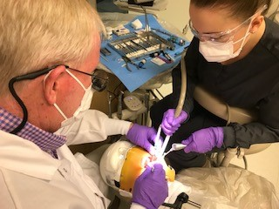
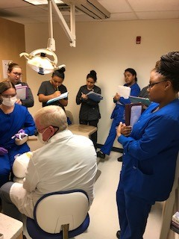
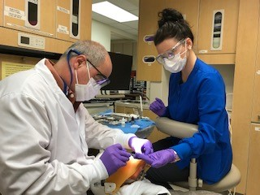
Dental Assisting - Intro
Notes:
At Forsyth Tech, we have a full service dental clinic that is used during the Fall semester for students to learn their pre-clinic skills. Students perform their pre-clinic skills on simulation manikins. During the Spring and Summer semesters our clinic is open to the public and students assist dentists with common dental procedures to include fillings and crowns.
Students also rotate through various offices in the community to refine and hone their skills. This is an internship style rotation where offices get a chance to see your skills in action. Often our graduates are offered jobs from an office they have rotated through.

Slide 3
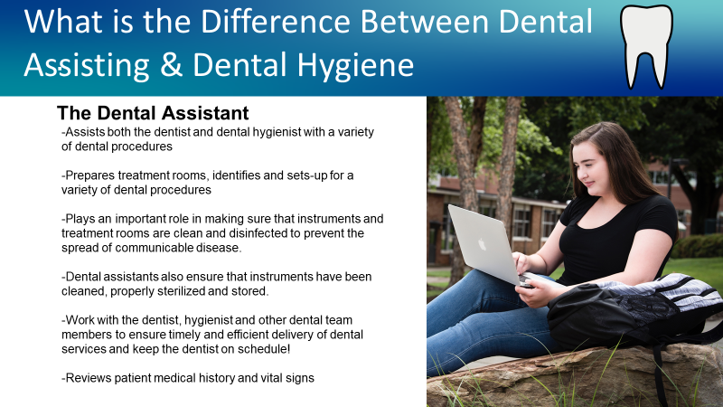
What is the Difference Between Dental Assisting & Dental Hygiene?
The Dental Assistant
  Assists both the dentist and dental hygienist with a variety of dental procedures
  Prepares treatment rooms, identifies and sets-up for a variety of dental procedures
  Plays an important role in making sure that instruments and treatment rooms are clean and disinfected to prevent the spread of communicable disease. Dental assistants also ensure that instruments have been cleaned, properly sterilized and stored.
  Work with the dentist, hygienist and other dental team members to ensure timely and efficient delivery of dental services and keep the dentist on schedule!
  Reviews patient medical history and vital signs

Slide 4

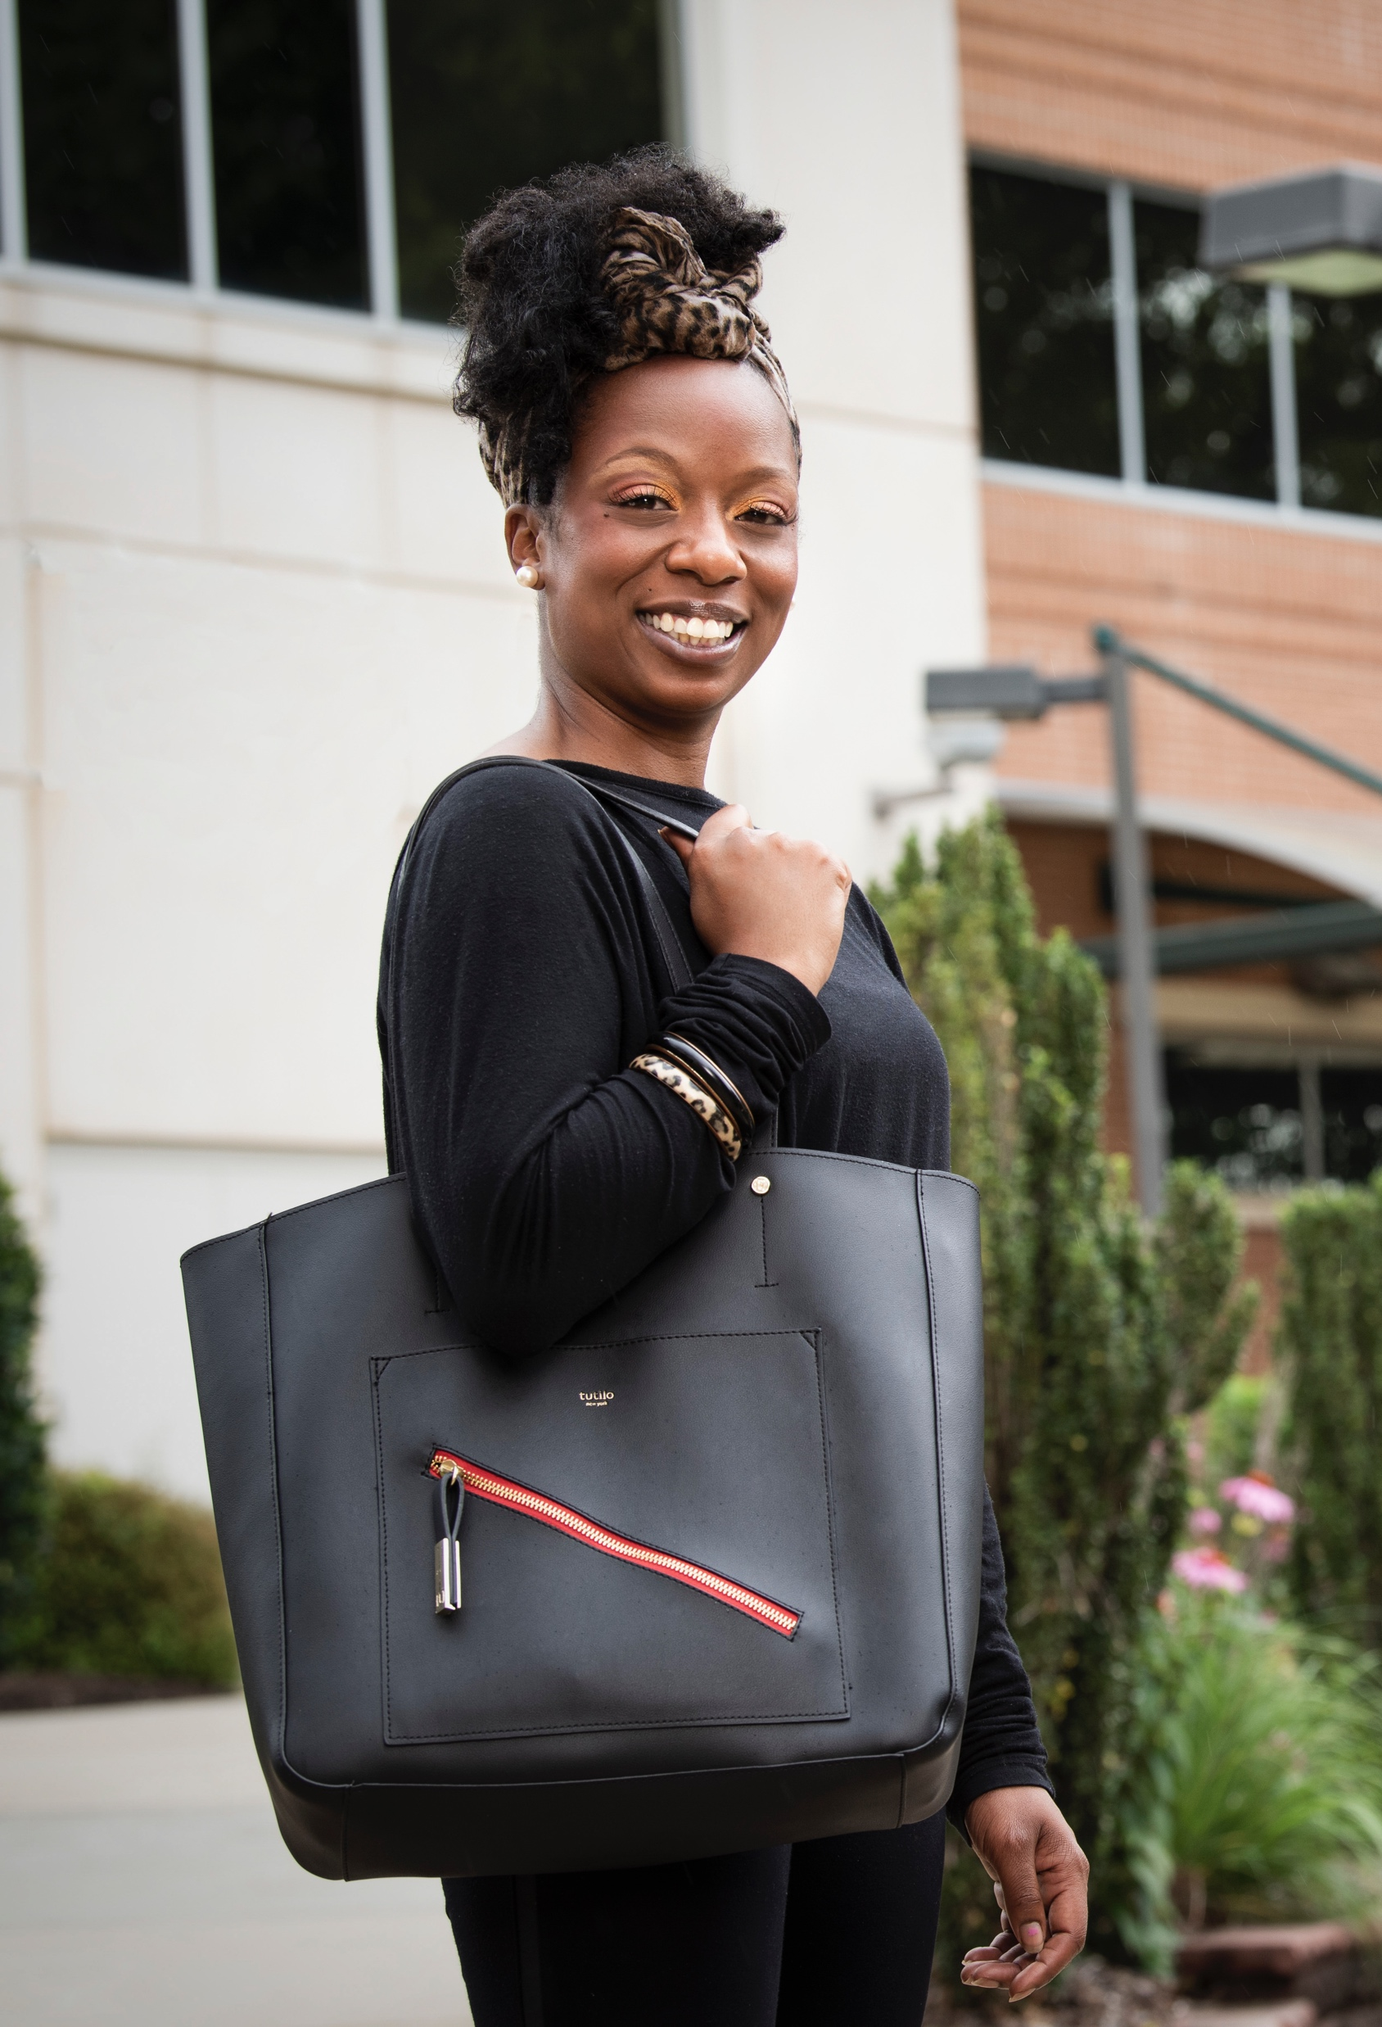
Dental Assisting – Job Duties
  -Works as a liaison between the patient and the dentist to convey information about dental procedures and post procedure instructions for care.
  - Dental assistants also discuss oral hygiene instruction as needed with patients.
  -Documents procedure details in the patient’s dental record
  -Takes dental radiographs
  -Takes dental impressions, pours-up dental models and fabricates bleaching trays and night guards as prescribed
  -Prepares lab orders for implants, crowns and other dental appliances.

Slide 5
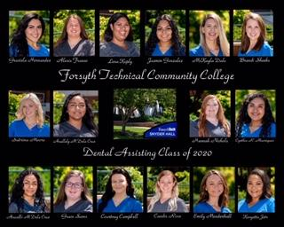
Dental Assisting – The Facts
-Good career- Most dental assistants work a 4 day week.
-Good living wage: Experienced Dental Assistants in the area make between $45-55k a year. This will vary dependent upon education and experience and also by specialty.
-DAII graduates can expect to earn $16-$20 per hour starting out

Slide 6

Dental Assisting Minimum Requirement’s & Requisite Courses
BIO 163 Basic Anatomy & Physiology; BIO 168 & 169 are accepted as a substitution for BIO 163, but you must take both 168 & 169 for equivalent credit hours.
PSY 150 General Psychology
ENG 111 Writing & Inquiry
RISE: Unweighted GPA used for Placement up to 10 years after graduation
  High School GPA 2.8+ Meets math and English minimum requirement. Can take requisite/college level courses right away. If you fall in this category you are eligible to apply to the program
  High School GPA 2.2-2.799 Places student into ENG 111 with co-requisite ENG 011 and MAT 003 through tier 1. You can begin to take other co-requisite courses at the same time as these courses. You must meet these minimum English and Math requirements prior to application to the program.
  High School GPA ≤ 2.1 ENG 002 through tier II & ACA 090 & Mat 003 through tier 1. Can be taken at the same time as requisite courses. You must meet these minimum English and Math requirements prior to application to the program.

Slide 7
Application Process
Dental Assisting accepts 20 students each Fall; 4 seats reserved for Surry Co. residents, 1 seat reserved for H.S. senior applicant.
We start a new cohort every year in the Fall; students typically graduate by July 1st each year.
Application Deadline is May, 21st for the Fall 2021 cohort

Slide 8
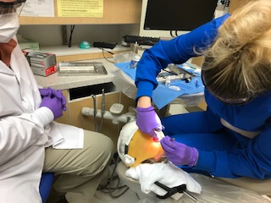
Student Selection
Students are selected by the admissions counselor based on total point accumulation. Points are earned in the following manner:
A=4 pts. B=3 pts. C=2pts.
Points are multiplied per course by credit hours for the course
Ex: BIO 163 = 5x3= 15 points received for BIO 163
Average Point range for selected students: 2020
Dental Assisting: 75.3-126*
* Cumulative points including TEAS test scores

Slide 9
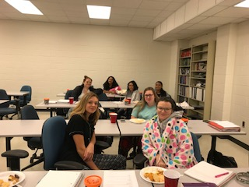
Application Process
Step 1 Review this Information session
Print off and sign the last page of this Power-Point and take with you to your MAR review.
Step 2 Complete Minimum Admissions Review (MAR) with admissions counselor.
Step 3 Take the TEAS test. Once you have completed the MAR review your name will be added to the TEAS test administrators list and you will be called within 2 weeks to schedule the test.
  Dental Assisting minimum score: 42
  Points at or above the minimum score will be added to your total point accumulation.

Slide 10
Application Process- Continued
September-December: Students who have finished requisite courses should meet with an admissions counselor in the Admissions Dept. for a Minimum Admissions Requirement (MAR) review.
December-May 1st: Students finishing requisite courses in the Fall, or who are continuing to take requisite courses into the Spring but who still want to apply should meet with an admissions counselor in the Admissions Dept. for a MAR review.
MAR reviews are conducted on a walk-in basis and you do not need an appointment. They are completed M-Th.
Schenika Silver Dental Admissions Counselor: 336-757-3626 but you may meet with any counselor
If you have further questions regarding the Dental Assisting Program please contact Kelly Cook Program Coordinator for Dental Assisting. 336-734-7447; kcook@forsythtech.edu

Slide 11
Dental Assisting Information Session
By signing this document you attest that you have reviewed the program information session for the 2020- 2021 Application period for the dental assisting program.
Name:_____________________________________________________
Date:_________________________________________
Signature:______________________________________________
Please print and sign your name, then take the form with you to the admissions office when you go for your MAR Review.

