Slide 1
Respiratory Therapy Program
Online Open House / Orientation
Notes:
Welcome to the online orientation for the respiratory therapy program at Forsyth Tech Community College.
Once you have completed the online presentation, you will be prompted to complete an online form stating that you have viewed the online orientation and understand the requirements for admission into the program. You will be asked for some identification information so the Respiratory Therapy Program and Forsyth Tech may contact you, if needed. Viewing this presentation is also a requirement for program admission, so completing the online form will serve as verification of completion.

Slide 2
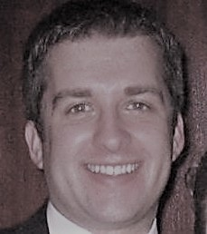
Welcome
Welcome!
The following presentation will provide you background on the respiratory therapy profession, as well as provide the steps necessary for program admission. Sit back and enjoy as you take your first step towards a rewarding career as a respiratory therapist!
John Sherman
Program Coordinator, Respiratory Therapy
Department Chair,
Health Services Programs
Notes:
My name is John Sherman and I am the program coordinator of the respiratory therapy program. I am in my second decade of teaching for the program, where I am also a proud alumnus. I am very excited that you have decided to take this first step towards beginning a new career as a practicing respiratory therapist.
The purpose of this presentation is to guide you to further information about the respiratory therapy profession, provide background on the structure and expectations of our program, as well as detail the selective admission process required for entry into our program.

Slide 3
Respiratory Therapy: Defined
Respiratory Therapy: Defined
RTs work to evaluate, treat, and care for patients with lung and heart disorders.
Notes:
A respiratory therapist’s job is to evaluate, treat, and care for those who suffer with breathing or other cardiopulmonary disorders. They help relieve the suffering of those with chronic emphysema. Therapists give emergency respiratory treatments to heart attack and stroke victims. Working under the supervision of physicians, respiratory therapists evaluate, assist in the diagnosis of, and treat diseases of the heart and lungs.
The level of illness and setting of patients can vary widely. RTs may be on-hand to assist in the delivery and subsequent care of a premature baby in the neonatal intensive care unit . . . Before being called to the emergency department to assist with airway management of an incoming trauma patient . . . followed by the discontinuation of support for a terminally ill patient. As you can see, a single shift as a respiratory therapist can expose you to intense, emotionally charged situations that requires individuals that work well under pressure and emergency situations.
Respiratory therapists care considered to be cardiopulmonary specialists and are commonly called to action whenever cardiopulmonary resuscitation is required. You will be trained to participate in any number of roles during a resuscitation attempt, although your primary responsibilities will usually involve maintaining or creating an airway for the patient to breathe. Before graduating from our program, you will hold certifications in Advanced Cardiac Life Support, Pediatric Advanced Life support, as well as Neonatal Resuscitation.

Slide 4
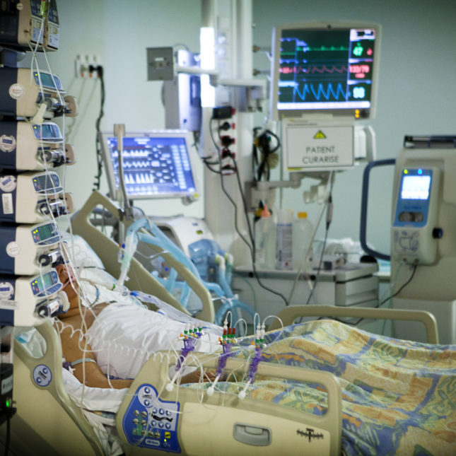
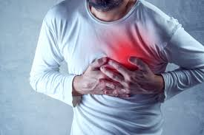
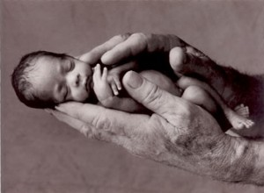
Respiratory Therapy: Our Patients
Lung disease
Heart disease
Neuromuscular disorders
Trauma
Premature babies
Children
Adults
The elderly
… and more!
Respiratory Therapy: Our Patients
Notes:
Respiratory therapists treat all age groups, from prematurely born babies to the elderly. While this list is by no means inclusive, the majority of patients treated by therapists have some disease or impairment of the heart and/or lungs. This includes conditions such as those caused by neuromuscular disease – those patients that lose function of the muscles of their body – or patients suffering from catastrophic injury from accidents or other forms of trauma.
During a typical shift you may be called to the bedside to acquire a blood sample through an arterial puncture, in order to assess carbon dioxide or oxygen levels. Or perhaps you may have to interview patients and perform chest physical examinations in order to determine what kind of therapy is best for their condition. Some respiratory therapists perform diagnostic pulmonary function tests, which may assess how well the lungs can move air in and out of the body, and assess the severity or progression of lung disease. A patient struggling to breathe may need supplemental oxygen or a breathing treatment, and the respiratory therapist will be there to respond. You may have to educate patients and their families about lung disease so they can maximize their recovery. Or you may be needed to manipulate the mechanical ventilator of a patient who is unable to breath adequately on their own.
Respiratory therapists are an integral part of the multidimensional healthcare delivery team. Therapists frequently interact with physician specialists, including pulmonologists, critical care surgeons and anesthesiologists, as well as those trained in pulmonary and cardiac rehabilitation. Physicians look to respiratory therapists for their expertise in cardiopulmonary disease, therapeutic measures, x-ray interpretation, ventilator management, arterial blood gas analysis, and much, much more. During your clinical rotations in our program, you will have the opportunity to interact and participate with physicians and other members of the healthcare team as treatment decisions are considered.
Regardless of your interests it is very easy to see that respiratory therapists have a hand in the care of most patients entering through the doors of our healthcare system today

Slide 5
All About Respiratory Therapy
Please take some time to
explore each of the links below!
All About Respiratory Therapy
Why be a respiratory therapist?
What is respiratory therapy????
Explore your path to respiratory therapy!
Notes:
There are ample resources out there describing the profession of respiratory therapy. I have selected some information that has been provided by the American Association for Respiratory Care (or AARC), which is the national professional organization for the practice of respiratory therapy. For this part of the presentation, I would like you to explore each of the three links currently displayed. All three are from the AARC Website “Be An RRT”; it provides great information about the Who, What, Where, When and Why of respiratory therapy – including background information on the career as well as short video clips from practicing therapists. Please take a few minutes and explore the website on your own, before you return to the presentation.

Slide 6
AARC Life and Breath Video
“Life and Breath”
Notes:
I hope you enjoyed the information on the American Association for Respiratory Care website. This next slide contains another video from the AARC. This production is a little bit older than the videos you viewed previously; however, the information is no less accurate or relevant. In addition to further discussion about the scope of practice for a respiratory therapist, there is also significant information about specialty areas, such as sleep medicine, pulmonary rehabilitation, homecare, and pediatrics. The video is around twenty minutes in length; if you do not have time to view it now, I highly suggest you bookmark the video on Youtube for later viewing. You can never have too much information, particularly when considering your future career.

Slide 7
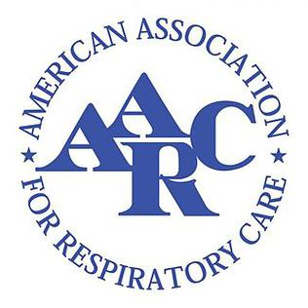
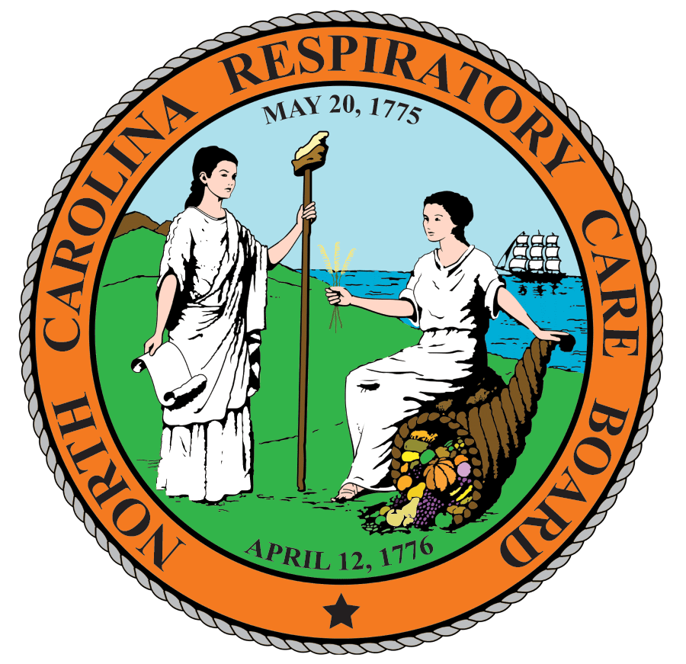
Where You Can Find Additional Information
Where You Can Find Additional Information . . .
Click on the pictures to learn more!
Notes:
AARC - Those interested in more information about the respiratory care profession can investigate the following websites. As mentioned, the American Association for Respiratory Care (AARC) is the leading national and international professional association for respiratory care. The AARC encourages and promotes professional excellence, advances the science and practice of respiratory therapy, and serves as an advocate for patients and their families, the public, the profession and the respiratory therapist.
NCRCB - In order to practice as a respiratory therapist, you must be licensed in the state in which you wish to work. The NCRCB is a non-profit organization that licenses respiratory care practitioners of North Carolina. The board will determine whether or not a person will be legally allowed to practice Respiratory Therapy in North Carolina.
NCSRC - The NCSRC is a non-profit organization that supports and benefits the Respiratory Care Practitioners of North Carolina. The NCSRC is a chartered affiliate of the American Association for Respiratory Care.
NBRC - The National Board for Respiratory Care, Inc. (NBRC) is a voluntary health certifying board which was created in 1960 to evaluate the professional competence of respiratory therapists.
CoARC - The Commission on Accreditation for Respiratory Care (CoARC) accredits professional respiratory care degree programs at the Associate, Baccalaureate, and Master’s Degree level in the United States as well as internationally. CoARC’s mission is to serve the public by promoting high quality respiratory therapy education through their accreditation services. Accreditation is a status that provides assurance to prospective students, their families and the general public that an institution (or a program) meets minimum requirements and that there are reasonable grounds to believe the program will continue to meet those standards in the future.

Slide 8
Admission Information
Admission Information
Please print or open the Respiratory Therapy MAR Packet and follow along with the presentation to complete the Admissions component.
Notes:
Now that you have learned a bit more about the respiratory care profession and the Respiratory Therapy Program at Forsyth Tech, we will next focus on the admission process. Before beginning this portion of the presentation, if you haven’t already, please print or link to our webpage and open up the Respiratory Therapy Minimum Admission Requirement (MAR) Packet and follow along with the presentation. Once you have the MAR packet available, please continue with the presentation.

Slide 9
Selective Admission Process
Selective Admission Process
Students compete for seats in the program based on a point ranking system
The program will admit 20-30 students for Fall, 2023, with two seats reserved for high school graduates
Pay attention to the deadline of May 19, 2023 – there are NO exceptions!
Upon your initial application, you will be admitted to the college in the Associate in Arts – Health Tech track, which will allow you to complete program related coursework
Notes:
Forsyth Tech’s Respiratory Therapy program is based upon selective admissions meaning that particular requirements must be met in order to be eligible for admission. It is also competitive due to the limited space for clinical sites. The Respiratory Therapy admits between 20 and 30 students each fall. Two seats are reserved for recent high school graduates. All competitive applicants are ranked based on a point system that we will discuss as we go through the MAR packet.
Please note the application deadline listed in your MAR packet and displayed on the screen. This is an important date to remember because all of the requirements must be met by this deadline in order for you to be considered for admission. There are no exceptions to this deadline. Since the application deadline occurs after the spring semester each year, you have the opportunity to complete related courses right up until before the application deadline. You will not be penalized for completing your MAR review near the application deadline. In the event of a tie, the applicant with the higher Related Courses points will be ranked higher.
If you are interested in beginning at Forsyth Tech to work on completing the related courses listed in your MAR packet, you will be admitted to the school in the Associate in Arts-Health Tech program; this is the track where all students are placed that are interested in a competitive admission health program.

Slide 10
Application Process
Complete an Application to Forsyth Tech
Complete the Respiratory Therapy Online Orientation
Demonstrate “College Readiness” in English and Math
Application Process
Demonstrate Biology Competency
Meet Requirements of “No D or F Policy”
Submit the online MAR application
Check your Forsyth Tech email
Notes:
The following steps must be completed by the application deadline in order to be a candidate for admission for next Fall’s respiratory therapy program cohort.
First of all, if you are a new or former student at the college, Submit the Forsyth Tech Application. This application can be completed online or in person at the Admissions Office in the Strickland Center on main campus. You will need to contact your high school or state General Equivalency Diploma (GED) office – whichever is relevant to you - to have an official transcript or GED scores sent to the Admissions Office. In order to be considered official, high school transcripts must be delivered in a sealed envelope.
If you have attended college in the past, please have official transcripts sent from ALL previously attended colleges sent to the Admissions Office to complete your application. Again, official transcripts must have the school seal or original signature and be delivered in a sealed, unopened envelope.
The next step is to complete the Respiratory Therapy Online Orientation / Open House . . . which you are obviously doing right now. At the end of this presentation, you will have an opportunity to complete an electronic signature form confirming that you have viewed the presentation.
Next, you need to be able to demonstrate your readiness in English and Math. There are many different ways to demonstrate competency in these two critical subjects, and I urge you to review the MAR packet for specific details. If you are unsure whether you meet either of these requirements, please reach out to a counselor in the Admissions Office PRIOR to submitting your MAR application, which will be discussed momentarily. Once the Admissions Office receives your MAR application, it will be reviewed to make sure you meet minimum program entry requirements.
Next, you must demonstrate minimum competency in Biology. This can be done with record of at least a “D” in a high school level biology course or a college level biology course with a “C” or better.
The program has a No D or F policy for related coursework. In other words, for any program related course (a listing of which can be found in the MAR packet and later on in this presentation), completed, you must have record of a grade of C or better . . . any grade of D or F will preclude you from completing a MAR review for program admission. If you currently have record of a D or F in a program related course, you will need to retake the course and earn a C or better prior to the next application deadline (and MAR review).
The next step in the admission process is to submit the online Respiratory Therapy MAR application. The application can be found on the website indicated in the MAR packet. Pay special attention to the dates listed in the MAR packet for when you can submit the MAR application. Remember: you MUST submit your MAR application BEFORE the program’s application deadline. Your application confirmation will be emailed to you at the time it has been completed by a counselor. You MUST make sure you have activated your Forsyth Tech email account so you can monitor for this communication. As long as you have submitted a MAR application, before the application deadline, your application will be reviewed, and you will be contacted by the deadline for the program that your MAR has been completed.
The last step in the process is to await the final response from the admissions team, via your Forsyth Tech email, as to your program status. You will be notified via email REGARDLESS of your status – whether you are admitted, an alternate, or not admitted. If you are admitted, you will receive instructions in your admissions letter with specific requirements that apply to admitted students. You will need to carefully review and follow those instructions in order to maintain your seat in the program. Alternates will be notified in ranked order if any seats open up during the new cohort onboarding process.

Slide 11
What Makes You a Competitive Applicant
What Makes you a COMPETITIVE Applicant?
Complete as many program related courses as possible prior to MAR review
THESE ARE NOT PREREQUISITES!
Must earn “C” or better
Related Experience Points - check out the MAR packet to see how you can earn additional points for selected previous degrees and certifications!
Notes:
Your competitiveness as an applicant will be primarily based on the points earned from the program’s related courses. In total, there are six courses that may be completed prior to entry in the program. These are courses that are already part of the program’s curriculum and must be completed in order to earn an associate in applied science degree. A listing of the courses is provided in the MAR packet as well as in this presentation. Please note: these courses are NOT prerequisite courses. Many students are confused by this and feel like all classes must be completed before applying. That is just not the case. As long as you meet the minimum requirements for English, math, and biology, as described earlier, you are free to complete the application process, including the MAR review, for entry into the program. However, historically the large majority of accepted students have completed at least some, if not most of the program related courses. The admissions office will utilize a point ranking system, that will be described momentarily, that utilizes the grades earned in the program related courses and assigns point values. The students with the highest point totals have the best chance of getting accepted.
In addition, extra points are available for selected previous degrees and certifications. The documentation to earn these points MUST be turned prior to the MAR Review. If you are going to complete any items for points prior to the deadline…do not submit the online MAR application until you have completed the item and have the documentation. Documentation can either be submitted to MAR@forsythtech.edu or dropped off at the admissions office. Please remember these items are NOT required. Pay close attention to the experience points section in the respiratory therapy MAR packet.
As a general rule, if points are given for degrees or diplomas, they are given for the highest credential earned. Review the packet as many times as necessary to become familiar with what is required and what will help make you more competitive for the Respiratory Therapy program.

Slide 12
Program Related Courses
Program Related Courses
Humanities / Fine Arts (one!)
Anatomy & Physiology
English / Communication
Psychology
Chemistry
English Composition
Art 111
HUM 110
HUM 115
HUM 121
HUM 160
MUS 110
PHI 215
PHI 240
REL 110
BIO 163
OR
BIO 165 & 166
OR
BIO 168 & 169
ENG 112
OR
ENG 114
OR
ENG 115
OR
COM 120
OR
COM 231
PSY 118
OR
PSY 150
CHM 131/131A
or higher
ENG 111
Notes:
On this slide you see a listing of the program’s related courses, which can also be found in the program’s MAR packet. Working from left to right on the screen, you see the that one course (3 credit hours) is needed in the humanities / fine arts category. The listing you see are the courses that have been previously approved in our program of study. If you have already completed a humanities or fine arts course not on this list, I encourage you to reach out to me and see if a substitution can be made so you will not have to take an additional course. Again, you will only need one course out of this category.
The next course described is anatomy and physiology. The majority of prospective students complete the BIO 163 option, which is a one-semester, 5-credit course. You do have the option to complete BIO 168 and BIO 169, which is the two-semester A&P option. Both courses are 4 credit hours each. BIO 165 and BIO 166 is also an option, although these courses are not available at Forsyth Tech. If you do complete BIO 165 and BIO 166, please note that BOTH of these courses MUST be completed at the same institution – that is not a requirement for BIO 168 and BIO 169. The A&P option is really up to you and your comfort level. BIO 163 is appropriate; however, some students feel like they would like a little bit more depth in the topics, which will be provided in the two-semester sequence.
You will be required to complete two English courses. The first course, ENG 111 (Writing and Inquiry) is listed on the far right of the screen. This course is required in the large majority of programs on campus. The secondary English/communication course provides multiple options, including ENG 112, 114, or 115; or COM 120 or 231.
You will also need to complete a psychology course. The large majority of students complete PSY 150 General Psychology. Also please note: if you are a student receiving financial aid, PSY 118 Interpersonal Psychology will NOT be covered, as it is not included in the Associate in Arts program of study. Remember that you will initially be placed in the AA program upon your initial application to the college. So while PSY 118 is an appropriate option for the respiratory therapy program, if you are trying to get the course completed prior to entering the program, and you receive financial aid, you are going to want to look for PSY 150 options.
Finally, the program requires a chemistry course. The course listed in our program of study is CHM 131 Introduction to Chemistry and CHM 131A the lab component for Introduction to Chemistry. Some students have already completed a 4 credit chemistry course like CHM 151, which is an applicable substitution for CHM 131. Generally, as long as the course you have completed is a level at or above CHM 131, is four credits and includes a lab component, it will be an acceptable substitution. Again, I encourage you to reach out to me personally if you have any questions about course substitutions for our required related coursework.

Slide 13
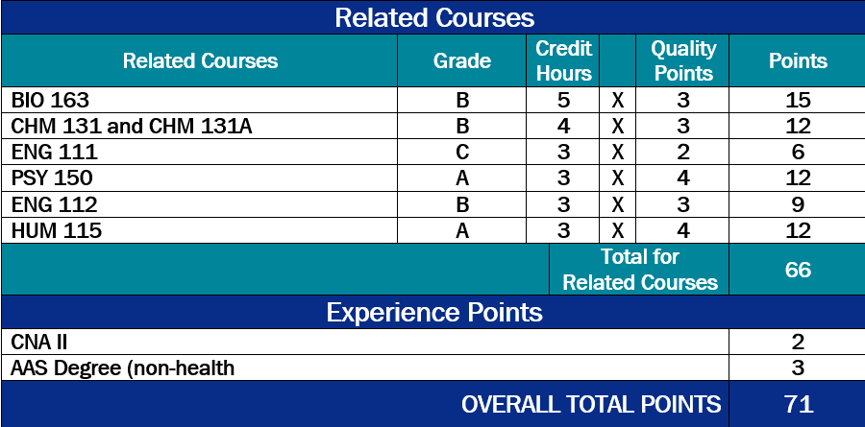
Points Ranking Example
Points are calculated by multiplying the grade earned
by the number of course credit hours
A = 4 points
B = 3 points
C = 2 points
Points Ranking Example
Notes:
Now let’s look at how your points will be calculated. When you are meeting with the counselor, they will go through the listed related courses and assign a point value for each one that you have completed. Grades are given a point value: An A will earn 4 points, a B 3 points, and a C 2 points. That number is then multiplied by the number of credit hours to give you a point total for that course.
In the example, this student earned a “B” in BIO 163, a course that is 5 credit hours. The 3 quality points earned for the grade of “B” is then multiplied by the number of credit hours to get to the total of 15 points for that course. One the next line, you see the student completed CHM 131 and CHM 131A with a grade of B. These courses are a total of 4 credit hours, which is then multiplied by the 3 quality points earned for the grade of B, equaling 12 total points for the course. The student completed ENG 111 with a grade of C; this grade, which equates to 2 quality points, is then multiplied by the credit hours, 3, to get to the total of 6 points for that course. The same calculation was made for the Psychology, second English, and humanities/fine arts elective courses.
In addition, this student gained additional experience points for having a CNA II certification, as well as a non-health-related Associate in Applied Sciences degree.
In this example, the student has an overall point total of 71. The MAR packet includes a table of accepted student point data for the past three years.

Slide 14
High School Applicants
High School Applicants
Meet Requirements for MAR Review
Application, view online orientation, English / Math college readiness, Biology requirement, no “D or F Policy”
Submit transcript after 1st semester, senior year
Submit before MAR review; review overall weighted GPA, results in specific courses in MAR packet
Calculation of Ranking Score
Score will include weighted GPA plus course grade points (page 6 of MAR packet for scale)
Complete only with other high school applicants
Notes:
This next slide is for high school applicants only. If you have already completed high school (any year other than the current application cycle), please skip this slide.
For current or recent high school graduates, you will follow the same initial steps of the application process. That will include completing the online application, viewing the online orientation (as you are doing right now!), ensuring readiness for English and math, completion of a biology course, as well as not having any D or F in any college coursework that you may have completed while in high school.
You will need to submit your high school transcripts; however, you want to make sure you submit these AFTER you have completed the first semester of your senior year. These transcripts will need to be submitted BEFORE your MAR review.
High school applicants will be ranked by points, which are calculated by adding the cumulative weighted GPA along with points earned in selected high school courses. These courses include algebra II, anatomy and physiology, biology, chemistry, physics, and health science / health occupations / medical. Standard courses and AP/honors courses have different point values, which can be found in the MAR packet. High school applicants will ONLY compete against other high school applicants for the two seats we hold each fall.

Slide 15
Frequently Asked Questions …
Frequently Asked Questions …
Are related courses required to be completed before applying to the program?
No. Related courses (as listed in your Respiratory Therapy information packet) are not required for admission into the program. However, due to the competitive admission process, those students who have completed some or all of the related courses will have higher point totals than those who have not, putting those students in a better position during selective admissions.
Are you able to work and go through the program all at the same time?
Yes. Many of our students do work at least on a part-time basis while they attend the program. However, it is important to note that while it may be possible to work full-time while also attending the program, the time commitments - both in and out of the classroom - make it extremely difficult for those students to ultimately succeed in the program and graduate. From our experience the best situation, if you must work, would be to do so on a part-time, as needed basis, which would allow for some degree of flexibility during times increased course and clinical requirements.

Slide 16
Frequently Asked Questions (continued) …
Frequently Asked Questions (continued) …
Do I have to obtain a criminal background check and drug screen prior to entering the program?
Yes. All ACCEPTED students are required to submit, at the cost to the student, to a criminal background check and drug screening prior to entering the program. Forsyth Tech and the Respiratory Therapy Program will NOT have access to the results of those screenings. However, clinical facilities will have access to that information and will decide, on a case-by-case basis, whether or not results from the criminal background or drug screening constitute dismissal of a student from that particular clinical site. Because you must be able to attend ALL clinical sites that are a part of our program, any student denied admission to a clinical site due to results of the criminal background or drug screening will not be allowed to continue in the Program.
What if I have been previously dismissed from employment at a Program clinical site?
If you have been dismissed from employment from an area hospital or clinical facility that utilizes respiratory therapists, please be advised that you may not be able to attend clinical rotations at that particular site. Because students must be able to attend all clinical sites that are a part of our program, this would constitute immediate dismissal from the program.

Slide 17
Frequently Asked Questions (some more) …
Frequently Asked Questions (some more) …
Can I attend the program on a part-time basis?
No. Courses in the Respiratory Therapy Program are offered in sequence in order for students to complete their studies in five semesters (two Fall Terms, two Spring terms, one summer term). Students admitted to the program must attend on a full-time basis.
Can I take classes at night and complete the program?
No. While some of the clinical rotations may occur in the late-evening hours, all curriculum courses are taught during the day, typically anywhere between the hours of 8:00 a.m. and 4 p.m.
Do you offer a weekend option for attending the program?
No. All courses, including clinical courses, meet during the week, Monday through Friday.

Slide 18
Frequently Asked Questions (and more) …
Frequently Asked Questions (and more) …
What time do clinical courses typically begin?
Because of the typical setup of Respiratory Therapy departments in the area, students can expect clinical courses to begin anywhere between 6:30 a.m. and 7:00 a.m. for hospital-based courses. Other specialty rotations such as pulmonary rehabilitation or homecare may have start times later in the morning, typically no later than 9:00 a.m. Clinical course assignments are chosen by the program's Clinical Coordinator and may constitute extra travel outside the immediate Winston-Salem area.
If I have another degree or college credits to transfer can I finish the degree in less time?
While you may be able to transfer credit from other institutions to fulfill the requirements of the related courses in our program, the respiratory therapy curriculum courses are designed to be taken in sequence, over five semesters. If you have attended another respiratory therapy program and wish to transfer to our program, transfer of credits and time required for completion of your degree will be considered on a case-by-case basis by the Program Coordinator.

Slide 19
Frequently Asked Questions (and even more) …
Frequently Asked Questions (and even more) …
What happens if I fail or cannot complete a course while in the program?
The courses within the Respiratory Therapy Program are designed to be taken in sequence and are only offered once per year. Any student who fails or does not complete a course within the curriculum will be forced to drop from the Program. That student will have the option, at the discretion of the Program Coordinator (and if space is available) to return to the program the following year in the corresponding term in which they were unsuccessful.
Do you have more than one yearly entry point to start the program?
The Respiratory Therapy Program accepts new students each Fall term only. Currently, the program accepts 20-30 students each fall. Two seats are reserved for recent high school graduates.
What are your pass rates like on the national credentialing board exams?
The program consistently have near 100% pass rates for first-time challengers of the Therapist Multiple Choice and Clinical Simulation Exams. Program pass rates can be found at Programmatic Outcomes Data - CoARC - Commission on Accreditation for Respiratory Care

Slide 20
Frequently Asked Questions (costs) …
Frequently Asked Questions (costs) …
What are the approximate costs to complete the program?
The following is a semester-by-semester estimated program costs analysis. The prospective student should keep in mind that these costs may vary and some represent typical averages. The analysis is also based on a full-time in-state student status and does not include costs associated with the general education and related courses. Course texts/materials costs are subject to change without notice. Tuition rates based on 2021-2022 costs. Tuition based only on RCP courses – program related courses are not included.
First Semester (Fall)
Tuition: $608.00
Textbooks (RCP only): $514.00
Stethoscope: $75.00
Liability Insurance: $18.00
Student Activity Fee: $35.00
Technology Fee: $30.00
Parking Decal: $25.00
Scrubs, Shoes, supplies $300.00
DataARc Fee: $80.00
TOTAL: $1685.00
Second Semester (Spring)
Tuition: $912.00
Textbooks (RCP only): $275.00
Student Activity Fee: $35.00
Technology Fee: $30.00
TOTAL: $1252.00

Slide 21
Frequently Asked Questions (more costs) …
Frequently Asked Questions (more costs) …
Third Semester (Summer)
Tuition: $532.00
Textbooks (RCP only): $175.00
RCP 222 Lab Fee: $35.00
TOTAL: $742.00
Fourth Semester (Fall)
Tuition: $912.00
Textbooks (RCP only): $172.00
Liability Insurance: $18.00
Student Activity Fee: $35.00
Technology Fee: $30.00
Parking Decal: $25.00
Neonatal Resuscitation Program Certification $10.00
TOTAL: $1202.00
Fifth Semester (Spring)
Tuition: $912.00
Textbooks (RCP only): $90.00
RCP 215 Lab Fee: $90.00
Student Activity Fee: $35.00
Technology Fee: $30.00
Pediatric Advanced Life Support Certification $10.00
Advanced Cardiac Life Support Certification $10.00
TOTAL: $1197.00
GRAND TOTAL for program (approximate) $6078.00

Slide 22
Frequently Asked Questions (Last One!) …
Frequently Asked Questions (Last One!) …
What is the typical course schedule for program courses?
RESPIRATORY THERAPY PROGRAM (RCP) COURSE SEQUENCE
Typical meeting days / times for RCP courses only (subject to change)
Semester One
RCP 110 Intro to Respiratory Care** M 9a-12p / W 9a-12p OR 1p-4p
RCP 113 RCP Pharmacology** M 1p-3p
RCP 132 RCP Clinical Practice I Th 8a-330p*
Semester Two
RCP 111 Therapeutics / Diagnostics** MW 9a-1230p
RCP 114 Cardiopulmonary Anat. & Physiology** T 9a-12p
RCP 115 Cardiopulmonary Pathophysiology** T 1p-3p
RCP 142 RCP Clinical Practice II Th 7a-1p*
Semester Three
RCP 112 Patient Management** MTW 9a-1p
RCP 152 RCP Clinical Practice III Th 7a-4:30p*
RCP 222 Special Practice Lab F 9a-1p
Semester Four
RCP 210 Critical Care Concepts** T 9a-12p, 1p-4p
RCP 214 Neo./ Ped.Respiratory Care** F 9a-1p
RCP 236 RCP Clinical Practice IV MW 630a-3p*
Semester Five
RCP 211 Advanced Monitoring / Procedures** T/Th 9a-12p
RCP 215 Career Preparation** Th 1p-4p
RCP 247 RCP Clinical Practice V MW 630a-4p*
Here you will find a listing of the typical days and times for RCP courses. Of note, program related courses are not included. Also, clinical times listed are approximate; specific times may differ based on the clinical facility.
*Clinical times will vary based on facility
** Due to the COVID-19 pandemic, some courses may be a completely online or blended/hybrid format**

Slide 23
Additional Questions?
Additional Questions?
Don’t forget to review the program’s
technical standards
at the end of the MAR packet
Notes:
At the end of the MAR packet is a listing of the program’s technical standards. It is very important that you review these standards to better understand the nonacademic standards, skills, and performance requirements expected of a student in the Respiratory Therapy Program.
If an accommodation is necessary to participate in the program, it is imperative to identify reasonable accommodations to those students who qualify under the Americans with Disabilities Act (ADA). Reasonableness is determined by the Disability Services Office (DSO) and the program on a case by-case basis utilizing the program technical standards. The accommodation needs to be in place prior to the start of the program, or it may delay your ability to start the program. It is the student’s responsibility to contact the DSO and request accommodations.

Slide 24
Contact the Program
Contact the Program
Email
Phone
Website
jsherman@forsythtech.edu
336.757.3288
Forsyth Tech Respiratory Therapy Program
Notes:
If you have any further questions or need to get in touch with me, please use the contact information on your screen. Email is probably the quickest way to get in touch with me.

Slide 25
Last Step! Complete the online confirmation form
LAST STEP! Please click HERE to access the Online Orientation Confirmation Form
You MUST complete this step, in order to receive credit for viewing this presentation!
Notes:
Viewing this online orientation/open house session is a requirement for program admission. In order to receive credit for viewing the presentation, you MUST click on the link and complete the confirmation form in its entirety. You will NOT receive credit for viewing the presentation until you complete this step!

Slide 26
Thank you!
THANK
YOU FOR LISTENING!
Notes:
Thank you for your time viewing this presentation. I hope you have a better idea of the respiratory therapy profession and program at Forsyth Tech. We look forward to working with you in the future!

